Slide 1
HTML, CSS, JavaScript
Crash course for fundamental web development
Computing club, September 19, 2019
Notes:
https://learn.shayhowe.com/html-css/building-your-first-web-page/
https://internetingishard.com/html-and-css/introduction/
https://www.slideshare.net/AnaCidre/html-and-css-crash-course
Talk about how this is just for exposure

Slide 2
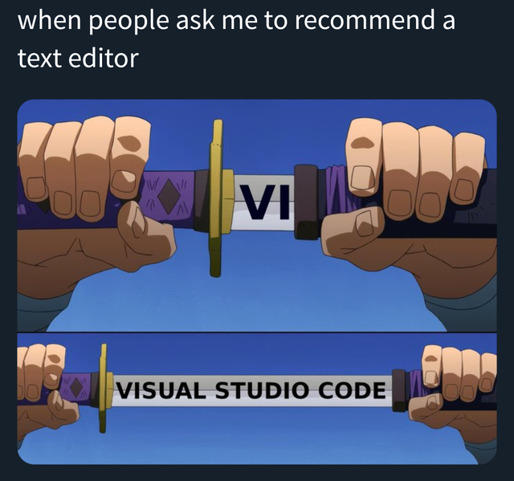
Follow along
Web Browser
Grab a text editor
Visual Studio Code
Or
Notepad++ (Most lightweight)
Atom
Sublime Text
Stop me if I’m going too fast
Notes:
Give everyone about 5 minutes

Slide 3

Why learn these things?
Web apps – Industry Apps
Basic HTML/CSS knowledge is essentially an expectation in the industry.
You can develop cross platform mobile apps with HTML/CSS/JS (Ionic framework).
JavaScript frameworks for EVERYWHERE
Front-end, Back-end, Mobile, Desktop, etc.
Notes:
A lot of applications in the industry are web apps.
Basic HTML/CSS knowledge is essentially an expectation in the industry.
You can develop cross platform mobile apps with HTML/CSS/JS (Ionic framework).
JavaScript frameworks EVERYWHERE
Front-end, Back-end, Mobile, Desktop, etc.

Slide 4
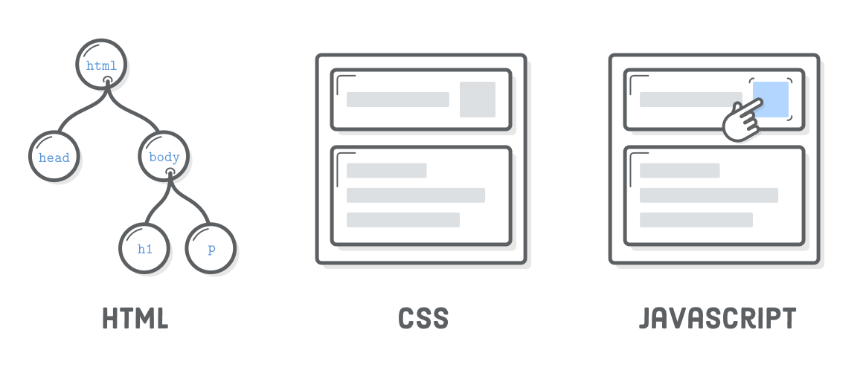
What is html, css, javascript
Structure
Formatting
Interaction
Notes:
HTML is the structure of the webpage
CSS is the design of the webpage
JavaScript is the engine of the webpage

Slide 5
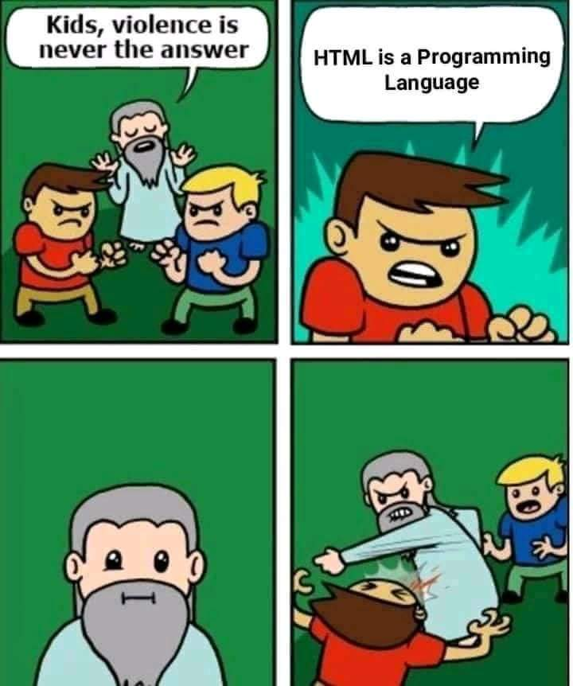
Starting off with HTML
Is NOT a programming language. - Markup Language
Web pages are made up of elements.
Elements are represented by tags.
You can change the attributes of the elements.

Slide 6
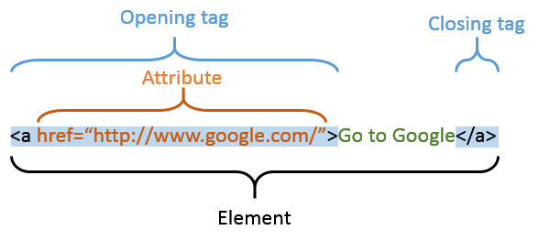

Slide 7
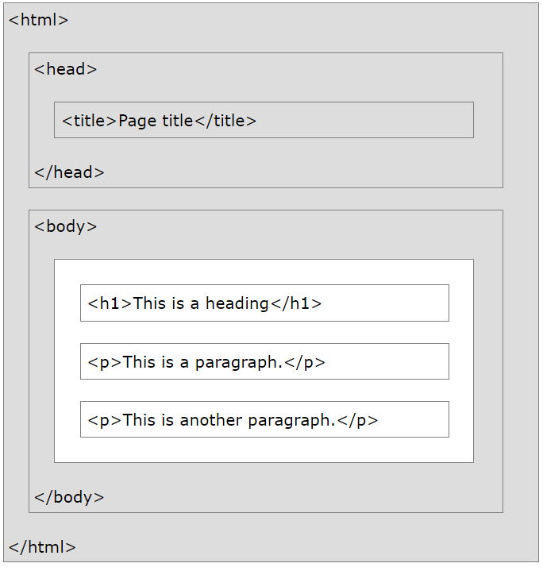

Slide 8
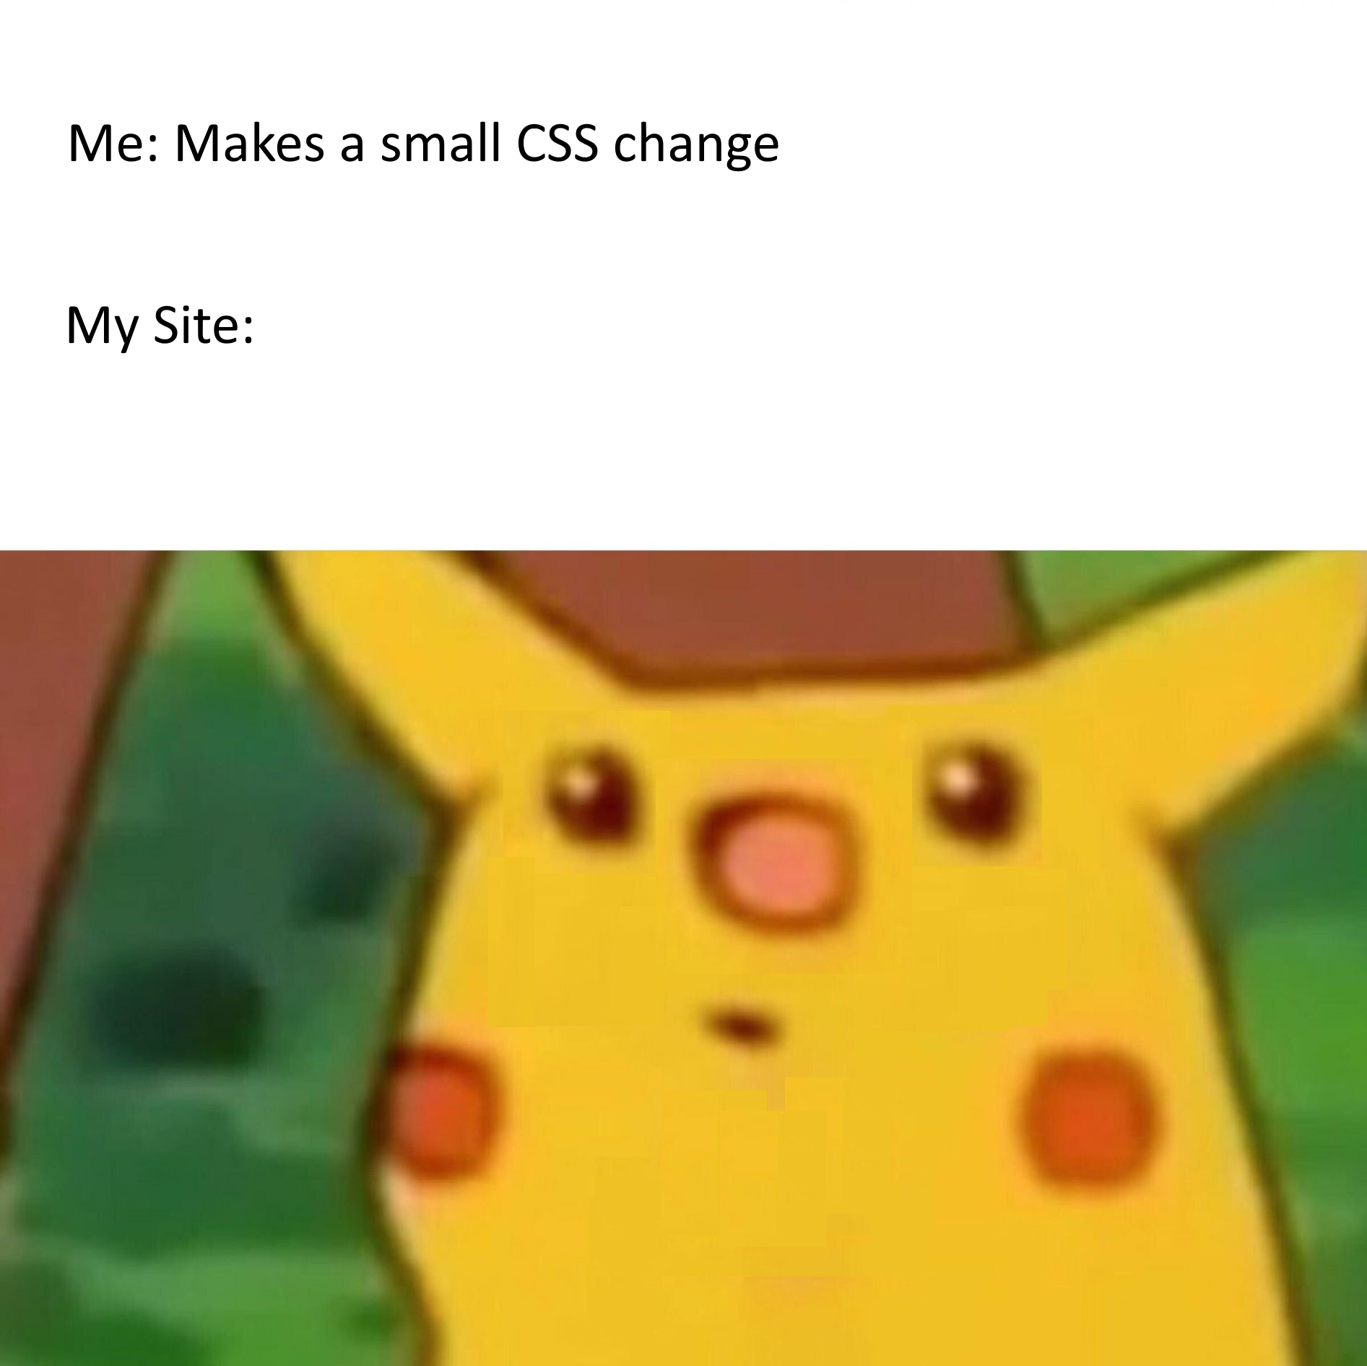
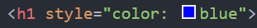
Styling: CSS and Selectors
CSS: Style sheets that make your webpage pretty!
3 Ways of Applying:
Inline – Styling using an attribute
Internal – Its own tag in HTML
External – In a separate file
Inline styling

Slide 9
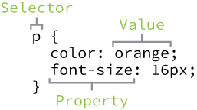
Applying CSS with selectors
Need a selector for internal & external CSS
SO many properties.
Selectors can be:
Elements
Classes (.)
Ids (#)

Slide 10
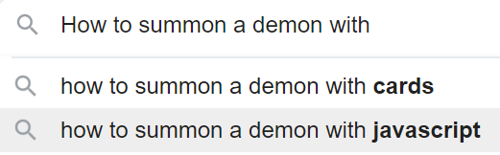
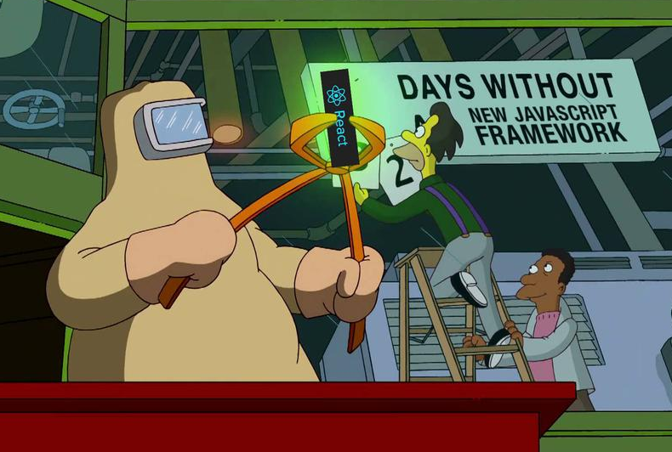
JavaScript
This is the engine/organs of your webpage
Interpreted programming language
You can do so much with JavaScript
Lets make something simple

Slide 11
Resources
Learning anything Web
W3 Schools: https://www.w3schools.com/default.asp
Validators
HTML: https://validator.w3.org/
CSS: https://jigsaw.w3.org/css-validator/
Recommended Frameworks:
jQuery: https://jquery.com/
Bootstrap: https://getbootstrap.com/
Fonts: https://fonts.google.com/
Notes:
Standards to web design today: Responsive

Slide 12

Next week
Atomic Object Git Workshop
Kirkhof Room 2266, 6pm
Bring laptops and resume
Git is a very important skill to know!
Hands-On experience is the way to learn

